Slide 1
Chapter 7 May 3
Ford-Fulkerson algorithm
Step-by-step walk through of an example
Worst-case number of augmentations
Edmunds-Karp modification
Time complexity bounds

Slide 2
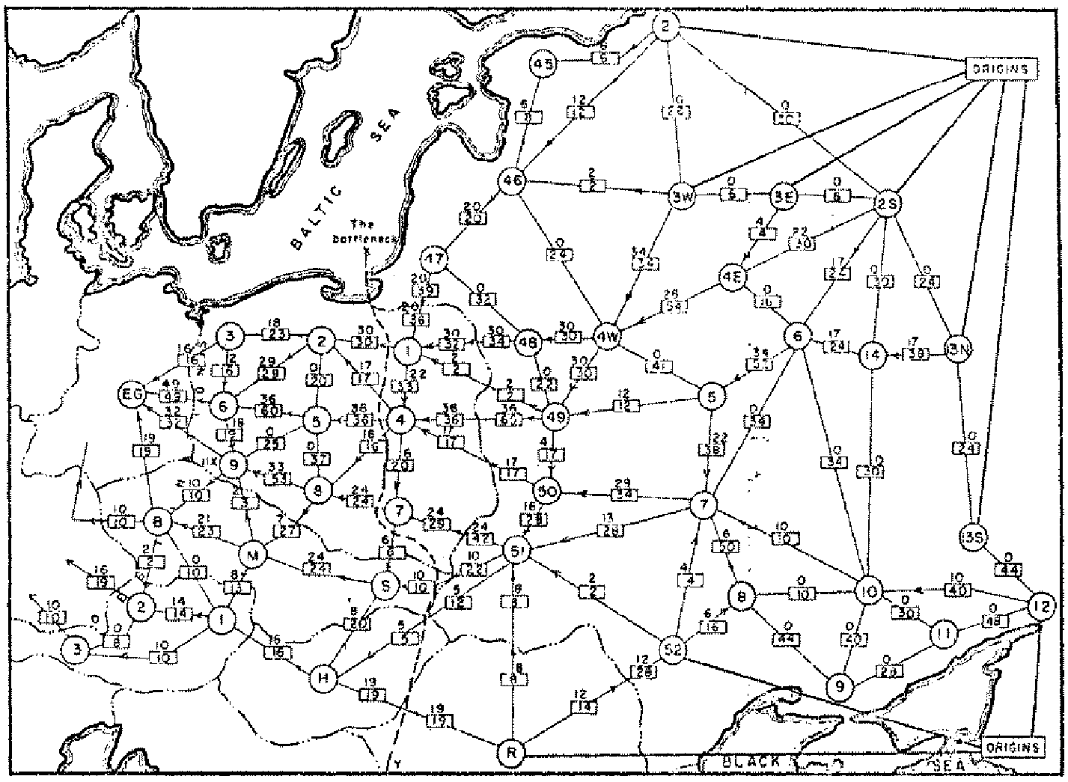
Soviet Rail Network, 1955
Reference: On the history of the transportation and maximum flow problems.
Alexander Schrijver in Math Programming, 91: 3, 2002.
Notes:
Russian scientist A. N. Tolstoi investigated soviet rail network. Wanted to optimize amount of cargo that could be shipped from origins in Soviet Union (right) to destination satellite counties (Poland, Czechoslovakia, Austria, Eastern Germany) (left). American scientists Harris and Ross were also interested in Soviet rail system but from a different perspective. In a secret report (declassified at Schrijver's request in 1999), Harris and Ross calculated a "minimum interdiction" of 163,000 tons.
after aggregation, 44 vertices, 105 edges

Slide 3
Maximum Flow and Minimum Cut
Max flow and min cut.
  Two very rich algorithmic problems.
  Cornerstone problems in combinatorial optimization.
  Beautiful mathematical duality.
Nontrivial applications / reductions.
  Data mining.
  Open-pit mining.
  Project selection.
  Airline scheduling.
  Bipartite matching.
  Baseball elimination.
  Image segmentation.
  Network connectivity.
  Network reliability.
  Distributed computing.
  Egalitarian stable matching.
  Security of statistical data.
  Network intrusion detection.
  Multi-camera scene reconstruction.
  Many many more . . .
Notes:
Network intrusion detection: http://www.ieee-infocom.org/2003/papers/46_02.PDF

Slide 4
Minimum Cut Problem
Flow network.
  Abstraction for material flowing through the edges.
  G = (V, E) = directed graph, no parallel edges.
  Two distinguished nodes: s = source, t = sink.
  c(e) = capacity of edge e.
2
9
5
10
4
15
15
10
source
s
5
3
8
6
10
t
sink
4
6
15
10
capacity
15
4
30
7
Notes:
source = where material originates, sink = where material goes.
We use cut to mean s-t cut.

Slide 5
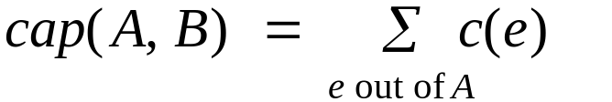
Cuts
Def. An s-t cut is a partition (A, B) of V with s ∈ A and t ∈ B.
Def. The capacity of a cut (A, B) is:
Capacity = 10 + 5 + 15
= 30
2
9
5
10
4
15
15
10
s
5
3
8
6
10
t
A
4
6
15
10
15
4
30
7

Slide 6
Cuts
Def. An s-t cut is a partition (A, B) of V with s ∈ A and t ∈ B.
Def. The capacity of a cut (A, B) is:
Capacity = 9 + 15 + 8 + 30
= 62
2
9
5
10
4
15
15
10
s
5
3
8
6
10
t
A
4
15
15
6
10
4
30
7
Notes:
7->3 not counted

Slide 7
Minimum Cut Problem
Min s-t cut problem. Find an s-t cut of minimum capacity.
Capacity = 10 + 8 + 10
= 28
2
9
5
10
4
15
15
10
s
5
3
8
6
10
t
A
4
6
15
10
15
4
30
7

Slide 8
Minimum Cut Problem
Min s-t cut problem. Find an s-t cut of minimum capacity.
Suppose the edge capacity represents the cost of removing the edge. What is the least expensive way to disrupt connection from s to t? This is the min-cut problem. Apparently, this is the version that motivated researchers in Rand corporation with a view of breaking down the Russian railway system.
Capacity = 10 + 8 + 10
= 28
2
9
5
10
4
15
15
10
s
5
3
8
6
10
t
A
4
6
15
10
15
4
30
7

Slide 9



Flows
Def. An s-t flow is a function that satisfies:
  For each e ∈ E: (capacity)
  For each v ∈ V – {s, t}: (conservation)
Def. The value of a flow f is:
0
2
9
5
4
0
0
10
4
4
15
15
0
10
0
4
4
s
5
3
8
6
10
t
0
0
capacity
4
0
6
15
0
10
15
flow
0
0
Value = 4
4
30
7
Notes:
source = where material originates, sink = where material goes
flow conservation = otherwise warehouse overfills or oil pipe bursts
flow conservation is analogous to Kirchoff's law
* flow: abstract entity generated at source, transmitted across edges, absorbed at sink
* assume no arcs enter s or leave t (makes a little cleaner, no loss of generality)

Slide 10
Flows
Def. An s-t flow is a function that satisfies:
  For each e ∈ E: (capacity)
  For each v ∈ V – {s, t}: (conservation)
Def. The value of a flow f is:
6
2
9
5
10
0
6
10
4
4
15
15
0
10
3
8
8
s
5
3
8
6
10
t
1
10
capacity
4
0
6
15
0
10
15
flow
11
11
Value = 24
4
30
7

Slide 11
Maximum Flow Problem
Max flow problem. Find s-t flow of maximum value.
2
9
5
10
4
15
15
10
9
s
5
10
3
8
1
6
10
9
t
0
0
4
4
6
15
10
9
15
8
4
30
4
7
10
capacity
0
0
flow
14
14
Value = 28
Notes:
Equalize inflow and outflow at every intermediate node.
Maximize flow sent from s to t.

Slide 12
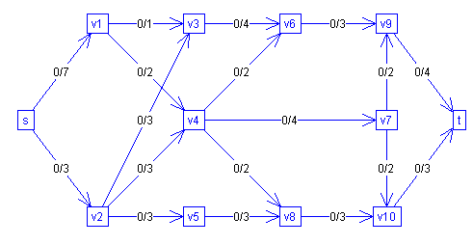
Java applet implementation:
http://www-b2.is.tokushima-u.ac.jp/~ikeda/suuri/maxflow/MaxflowApp.shtml?demo5
What is the capacity of the cut < {s}, V \ {s} >?

Slide 13
Java applet implementation:
http://www-b2.is.tokushima-u.ac.jp/~ikeda/suuri/maxflow/MaxflowApp.shtml?demo5
What is the capacity of the cut < {s}, V \ {s} >?
10
What is the capacity of the cut < V\ {v9, t}, {v9, t}>?

Slide 14
Java applet implementation:
http://www-b2.is.tokushima-u.ac.jp/~ikeda/suuri/maxflow/MaxflowApp.shtml?demo5
What is the capacity of the cut < {s}, V \ {s} >?
10
What is the capacity of the cut < V\ {v9, t}, {v9, t}>?
8

Slide 15
Java applet implementation:
http://www-b2.is.tokushima-u.ac.jp/~ikeda/suuri/maxflow/MaxflowApp.shtml?demo5
What is the capacity of the min-cut?

Slide 16
Java applet implementation:
http://www-b2.is.tokushima-u.ac.jp/~ikeda/suuri/maxflow/MaxflowApp.shtml?demo5
What is the capacity of the min-cut?
It is not obvious! Can you find a cut of capacity 6?

Slide 17
Java applet implementation:
http://www-b2.is.tokushima-u.ac.jp/~ikeda/suuri/maxflow/MaxflowApp.shtml?demo5
What is the capacity of the min-cut?
It is not obvious! Can you find a cut of capacity 6?
Answer: < {s, v1}, V \ {s, v1}>
Max-flow algorithm will find a cut of minimum capacity.

Slide 18

Flows and Cuts
Flow value lemma. Let f be any flow, and let (A, B) be any s-t cut. Then, the net flow sent across the cut is equal to the amount leaving s.
6
2
9
5
10
0
6
10
4
4
15
15
0
10
3
8
8
s
5
3
8
6
10
t
A
1
10
4
0
6
15
0
10
15
11
11
Value = 24
4
30
7

Slide 19
Flows and Cuts
Flow value lemma. Let f be any flow, and let (A, B) be any s-t cut. Then, the net flow sent across the cut is equal to the amount leaving s.
6
2
9
5
10
0
6
10
4
4
15
15
0
10
3
8
8
s
5
3
8
6
10
t
A
1
10
4
0
6
15
0
10
15
11
11
Value = 6 + 0 + 8 - 1 + 11
= 24
4
30
7
Notes:
total amount of flow that leaves S minus amount flow that "swirls" back

Slide 20
Flows and Cuts
Flow value lemma. Let f be any flow, and let (A, B) be any s-t cut. Then, the net flow sent across the cut is equal to the amount leaving s.
6
2
9
5
10
0
6
10
4
4
15
15
0
10
3
8
8
s
5
3
8
6
10
t
A
1
10
4
0
6
15
0
10
15
11
11
Value = 10 - 4 + 8 - 0 + 10
= 24
4
30
7

Slide 21

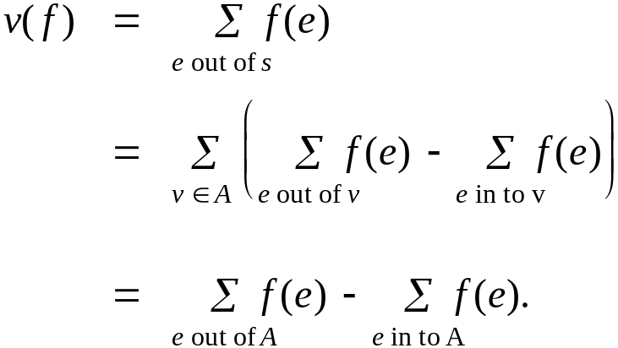
Flows and Cuts
Flow value lemma. Let f be any flow, and let (A, B) be any s-t cut. Then
Pf.
by flow conservation, all terms
except v = s are 0

Slide 22
Flows and Cuts
Weak duality. Let f be any flow, and let (A, B) be any s-t cut. Then the value of the flow f is at most the capacity of the cut (A, B).
Cut capacity = 30 ⇒ Flow value ≤ 30
2
9
5
10
4
15
15
10
s
5
3
8
6
10
t
A
4
6
15
10
15
Capacity = 30
4
30
7

Slide 23
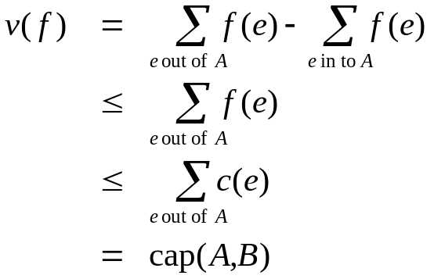
Flows and Cuts
Weak duality. Let f be any flow. Then, for any s-t cut
(A, B) we have v(f) ≤ cap(A, B).
Pf.
▪
A
B
4
8
t
s
7
6

Slide 24
Certificate of Optimality
Corollary. Let f be any flow, and let (A, B) be any cut.
If v(f) = cap(A, B), then f is a max flow and (A, B) is a min cut.
Value of flow = 28
Cut capacity = 28 ⇒ Flow value ≤ 28
9
2
9
5
10
1
9
10
4
0
15
15
0
10
4
8
9
s
5
3
8
6
10
t
4
10
A
4
0
6
15
0
10
15
14
14
4
30
7

Slide 25
Towards a Max Flow Algorithm
Greedy algorithm.
  Start with f(e) = 0 for all edge e ∈ E.
  Find an s-t path P where each edge has f(e) < c(e).
  Augment flow along path P.
  Repeat until you get stuck.
1
0
0
20
10
s
30
0
t
10
20
0
0
Flow value = 0
2

Slide 26
Towards a Max Flow Algorithm
Greedy algorithm.
  Start with f(e) = 0 for all edge e ∈ E.
  Find an s-t path P where each edge has f(e) < c(e).
  Augment flow along path P.
  Repeat until you get stuck.
1
20
0
0
X
20
10
30
0
20
t
s
X
10
20
0
0
20
Flow value = 20
X
2

Slide 27
Towards a Max Flow Algorithm
Greedy algorithm.
  Start with f(e) = 0 for all edge e ∈ E.
  Find an s-t path P where each edge has f(e) < c(e).
  Augment flow along path P.
  Repeat until you get stuck.
locally optimality ⇒ global optimality
1
1
20
0
20
10
20
10
20
10
s
30
20
t
s
30
10
t
10
20
10
20
0
20
10
20
greedy = 20
2
opt = 30
2

Slide 28
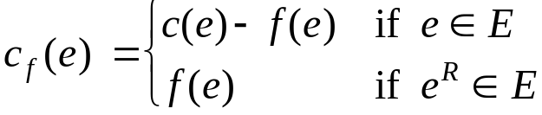
Residual Graph
Original edge: e = (u, v) ∈ E.
  Flow f(e), capacity c(e).
Residual edge.
  "Undo" flow sent.
  e = (u, v) and e^{R} = (v, u).
  Residual capacity:
Residual graph: G_{f} = (V, E_{f} ).
  Residual edges with positive residual capacity.
  E_{f} = {e : f(e) < c(e)} ∪ {e^{R} : c(e) > 0}.
capacity
u
17
v
6
flow
residual capacity
u
11
v
6
residual capacity

Slide 29
Ford-Fulkerson Algorithm
2
4
4
capacity
G:
10
2
8
6
10
s
10
3
9
5
10
t

Slide 30
Augmenting Path Algorithm
Augment(f, c, P) {
b ← bottleneck(P)
foreach e ∈ P {
if (e ∈ E) f(e) ← f(e) + b
else f(e^{R}) ← f(e) - b
}
return f
}
forward edge
reverse edge
Ford-Fulkerson(G, s, t, c) {
foreach e ∈ E f(e) ← 0
G_{f} ← residual graph
while (there exists augmenting path P) {
f ← Augment(f, c, P)
update G_{f}
}
return f
}

Slide 31
Max-Flow Min-Cut Theorem
Augmenting path theorem. Flow f is a max flow iff there are no augmenting paths.
Max-flow min-cut theorem. [Ford-Fulkerson 1956] The value of the max flow is equal to the value of the min cut.
Proof strategy. We prove both simultaneously by showing the TFAE:
  (i) There exists a cut (A, B) such that v(f) = cap(A, B).
  (ii) Flow f is a max flow.
  (iii) There is no augmenting path relative to f.
(i) ⇒ (ii) This was the corollary to weak duality lemma.
(ii) ⇒ (iii) We show contrapositive.
  Let f be a flow. If there exists an augmenting path, then we can improve f by sending flow along path.

Slide 32
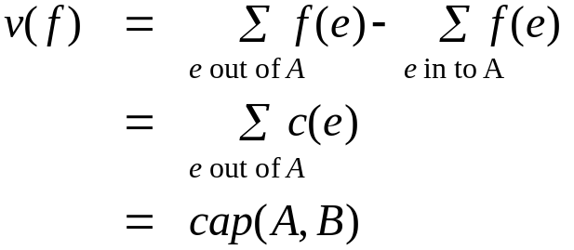
Proof of Max-Flow Min-Cut Theorem
(iii) ⇒ (i)
  Let f be a flow with no augmenting paths.
  Let A be set of vertices reachable from s in residual graph.
  By definition of A, s ∈ A.
  By definition of f, t ∉ A.
A
B
t
s
original network

Slide 33
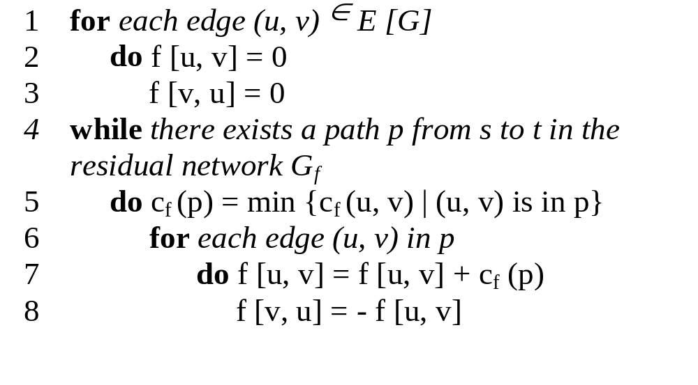
The basic Ford Fulkerson algorithm

Slide 34
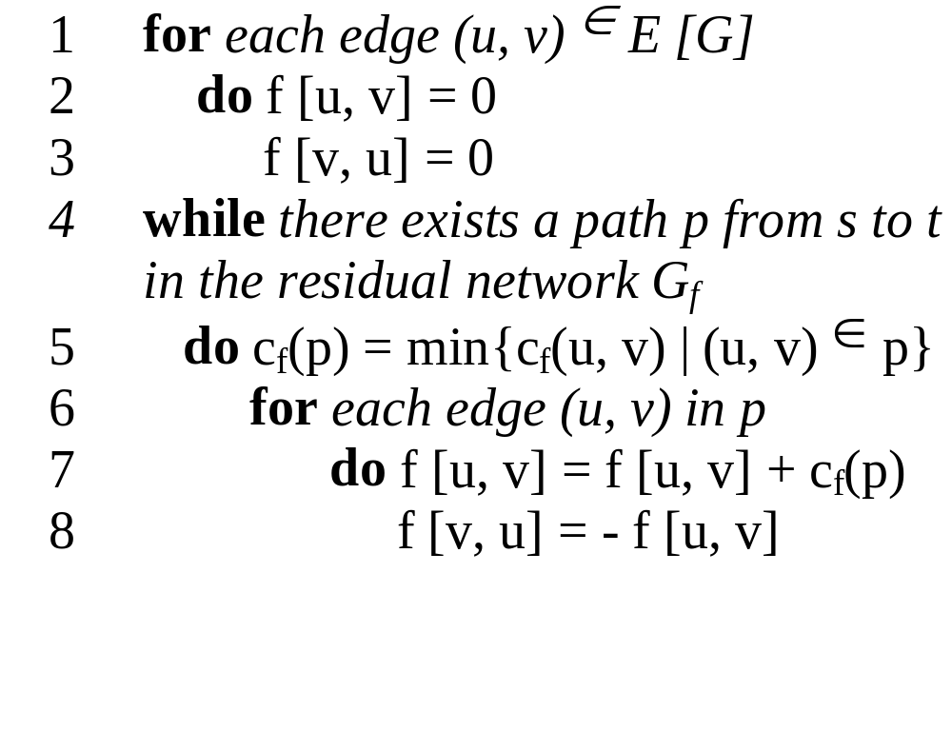
The basic Ford Fulkerson algorithm example of an execution
(residual) network G_{f}
v1
12
v3
16
20
10
4
7
S
9
t
4
13
v2
v4
14

Slide 35
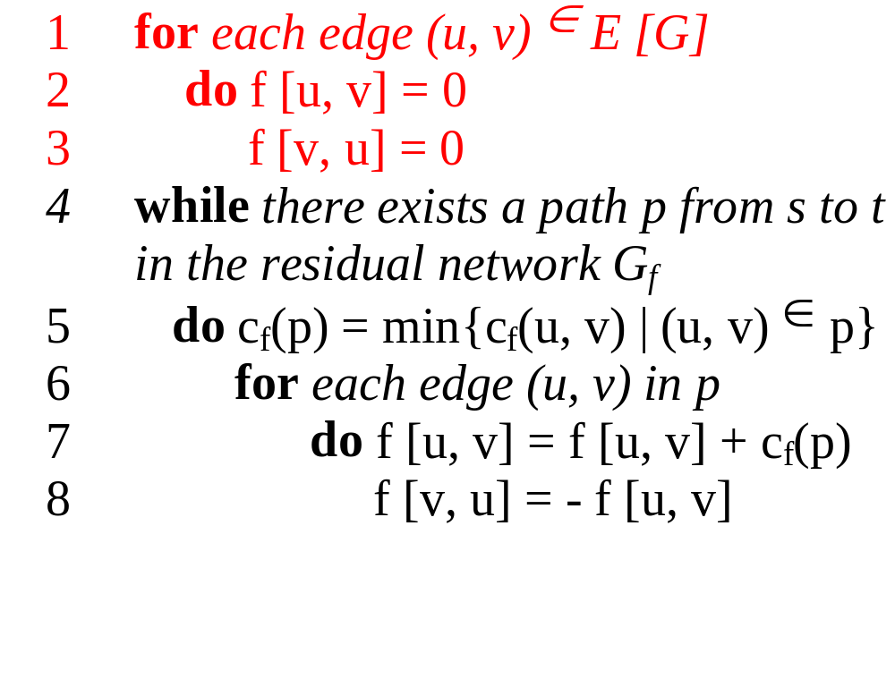
The basic Ford Fulkerson algorithm example of an execution
(residual) network G_{f}
v1
0/12
v3
0/16
0/20
0/10
0/4
7
S
0/9
t
0/4
0/13
v2
v4
0/14

Slide 36
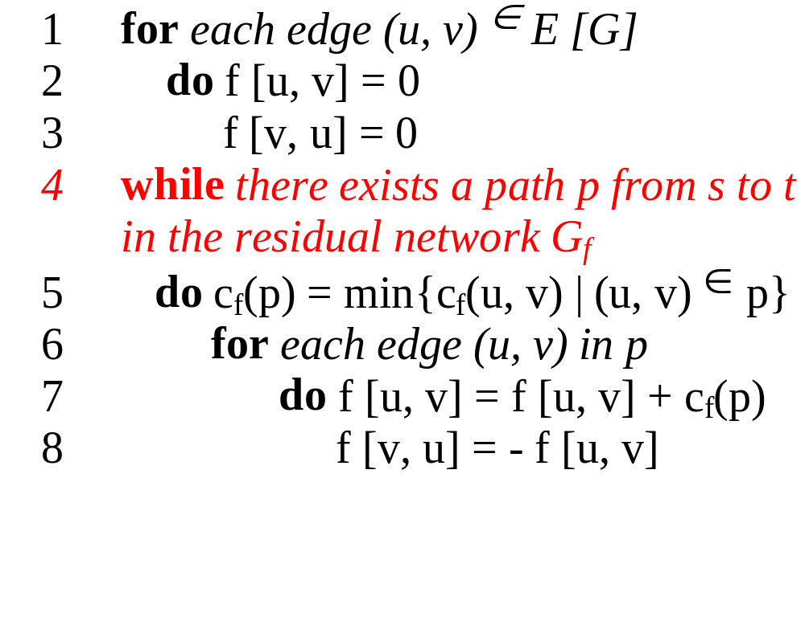
The basic Ford Fulkerson algorithm example of an execution
(residual) network G_{f}
v1
12
v3
16
20
10
4
7
S
9
t
4
13
v2
v4
14

Slide 37
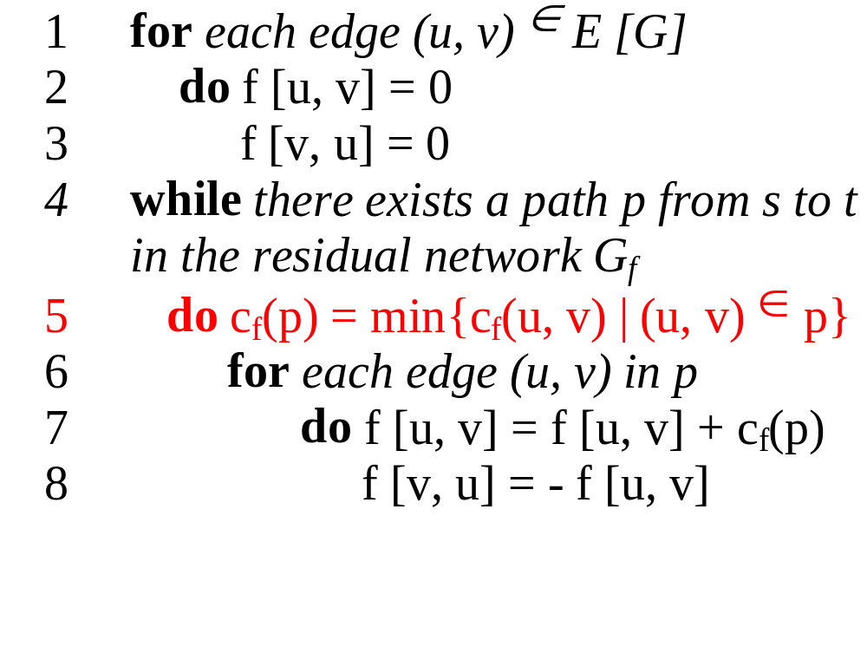
The basic Ford Fulkerson algorithm example of an execution
(residual) network G_{f}
v1
12
v3
16
20
10
4
7
S
9
t
4
13
v2
v4
14
temporary variable:
c_{f} (p) = 12

Slide 38
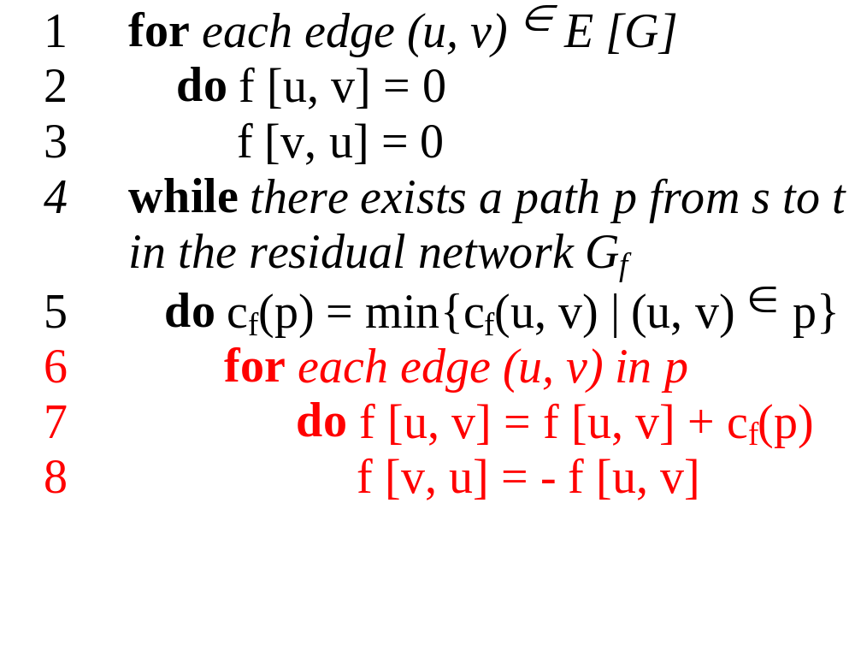
The basic Ford Fulkerson algorithm example of an execution
(residual) network G_{f}
v1
12
v3
16
20
10
4
7
S
9
t
4
13
v2
v4
14
new flow network G
v1
12/12
v3
12/16
12/20
temporary variable:
c_{f} (p) = 12
10
4
7
S
9
t
4
13
v2
v4
14

Slide 39
The basic Ford Fulkerson algorithm example of an execution
(residual) network G_{f}
v1
12
v3
4
8
12
12
10
4
7
S
9
t
4
13
v2
v4
14
new flow network G
v1
12/12
v3
12/16
12/20
10
4
7
S
9
t
4
13
v2
v4
14

Slide 40
The basic Ford Fulkerson algorithm example of an execution
(residual) network G_{f}
v1
12
v3
4
8
12
12
10
4
7
S
9
t
4
13
v2
v4
14
new flow network G
v1
12/12
v3
12/16
12/20
10
4
7
S
9
t
4
13
v2
v4
14

Slide 41
The basic Ford Fulkerson algorithm example of an execution
(residual) network G_{f}
v1
12
v3
4
8
12
12
10
4
7
S
9
t
4
13
v2
v4
14
new flow network G
v1
12/12
v3
12/16
12/20
10
4
7
S
9
t
4
13
v2
v4
14

Slide 42
The basic Ford Fulkerson algorithm example of an execution
(residual) network G_{f}
v1
12
v3
4
8
12
12
10
4
7
S
9
t
4
13
v2
v4
14
new flow network G
v1
12/12
v3
12/16
12/20
10
4
7
S
9
t
temporary variable:
c_{f} (p) = 4
4
13
v2
v4
14

Slide 43
The basic Ford Fulkerson algorithm example of an execution
(residual) network G_{f}
v1
12
v3
4
8
12
12
10
4
7
S
9
t
4
13
v2
v4
14
new flow network G
v1
12/12
v3
12/16
12/20
temporary variable:
c_{f} (p) = 4
10
4
7
S
9
t
4/4
4/13
v2
v4
4/14

Slide 44
The basic Ford Fulkerson algorithm example of an execution
(residual) network G_{f}
v1
12
v3
4
8
12
12
10
4
7
S
9
t
4
4
4
9
v2
v4
10
new flow network G
v1
12/12
v3
12/16
12/20
10
4
7
S
9
t
4/4
4/13
v2
v4
4/14

Slide 45
The basic Ford Fulkerson algorithm example of an execution
(residual) network G_{f}
v1
12
v3
4
8
12
12
10
4
7
S
9
t
4
4
4
9
v2
v4
10
new flow network G
v1
12/12
v3
12/16
12/20
10
4
7
S
9
t
4/4
4/13
v2
v4
4/14

Slide 46
The basic Ford Fulkerson algorithm example of an execution
(residual) network G_{f}
v1
12
v3
4
8
12
12
10
4
7
S
9
t
4
4
4
9
v2
v4
10
new flow network G
v1
12/12
v3
12/16
12/20
10
4
7
S
9
t
4/4
4/13
v2
v4
4/14

Slide 47
The basic Ford Fulkerson algorithm example of an execution
(residual) network G_{f}
v1
12
v3
4
8
12
12
10
4
7
S
9
t
4
4
4
9
v2
v4
10
new flow network G
v1
12/12
v3
12/16
12/20
temporary variable:
c_{f} (p) = 7
10
4
7
S
9
t
4/4
4/13
v2
v4
4/14

Slide 48
The basic Ford Fulkerson algorithm example of an execution
(residual) network G_{f}
v1
12
v3
4
8
12
12
10
4
7
S
9
t
4
4
4
9
v2
v4
10
new flow network G
v1
12/12
v3
12/16
19/20
temporary variable:
c_{f} (p) = 7
10
4
7/7
S
9
t
4/4
11/13
v2
v4
11/14

Slide 49
The basic Ford Fulkerson algorithm example of an execution
(residual) network G_{f}
v1
12
v3
4
1
12
19
10
4
7
S
9
t
11
11
4
2
v2
v4
3
new flow network G
v1
12/12
v3
12/16
19/20
10
4
7/7
S
9
t
4/4
11/13
v2
v4
11/14

Slide 50
The basic Ford Fulkerson algorithm example of an execution
(residual) network G_{f}
v1
12
v3
4
1
12
19
10
4
7
S
9
t
11
11
4
2
v2
v4
3
new flow network G
v1
12/12
v3
12/16
19/20
10
4
7/7
Finally we have:
| f | = f (s, V) = 23
S
9
t
4/4
11/13
v2
v4
11/14

Slide 51
Running Time
Assumption. All capacities are integers between 1 and C.
Invariant. Every flow value f(e) and every residual capacities c_{f} (e) remains an integer throughout the algorithm.
Theorem. The algorithm terminates in at most v(f*) ≤ n C iterations.
Pf. Each augmentation increase value by at least 1. ▪
Corollary. If C = 1, Ford-Fulkerson algorithm runs in O(mn) time.
Integrality theorem. If all capacities are integers, then there exists a max flow f for which every flow value f(e) is an integer.
Pf. Since algorithm terminates, theorem follows from invariant. ▪

Slide 52
7.3 Choosing Good Augmenting Paths

Slide 53

Analysis of the Ford Fulkerson algorithm
Running time (arbitrary choice of p)
O(|E|)
O(|E|)
O(|E| |f_{max}|)
O(|E|)
running time: O ( |E| |f_{max}| )
with f_{max} as maximum flow
(1) The augmenting path is chosen arbitrarily and all capacities are integers
Notes:
breath first search or depth first search

Slide 54
Analysis of the Ford Fulkerson algorithm
Running time (arbitrary choice of p)
Consequencies of an arbitrarily choice:
Example if |f*| is large:
v1
1,000,000
1,000,000
s
1
t
1,000,000
1,000,000
v2
running time: O ( |E| |f_{max}| )
with f_{max} as maximum flow
(1) The augmenting path is chosen arbitrarily and all capacities are integers

Slide 55
Analysis of the Ford Fulkerson algorithm
Running time (arbitrary choice of p)
Consequencies of an arbitrarily choice:
Example if |f*| is large:
residual network G_{f}
v1
v1
1 / 1,000,000
1,000,000
999,999
1,000,000
1
s
1 / 1
t
s
1
t
1
1,000,000
1 / 1,000,000
1,000,000
999,999
v2
v2
running time: O ( |E| |f_{max}| )
with f_{max} as maximum flow
(1) The augmenting path is chosen arbitrarily and all capacities are integers

Slide 56
Analysis of the Ford Fulkerson algorithm
Running time (arbitrary choice of p)
Consequencies of an arbitrarily choice:
Example if |f*| is large:
residual network G_{f}
v1
v1
1 / 1,000,000
1 / 1,000,000
999,999
999,999
1
1
s
1
t
s
1
t
1
1
1 / 1,000,000
1 / 1,000,000
999,999
999,999
v2
v2
running time: O ( |E| |f_{max}| )
with f_{max} as maximum flow
(1) The augmenting path is chosen arbitrarily and all capacities are integers

Slide 57
Analysis of the Ford Fulkerson algorithm
Running time with Edmonds-Karp algorithm
Informal idea of the proof:
for all vertices v ∈ V\{s,t}:
the shortest path distance δ_{f}(s,v) in G_{f} increases monotonically with each flow augmentation
δ_{f} (s,v) < δ_{f´} (s,v)
u1
4
v3
6
6
2
2
S
t
4
4
u2
v4
4
running time: O ( |V| |E|² )
(2) Edmonds-Karp algorithm
augmenting path is found by breath-first search and has to be a shortest path from p to t
Notes:
unit distances

